Slide 1
Solving the N-Queens problem through Minimum Conflicts Algorithm
Presented By: Juri Ando, Joseph Gleason

Slide 2
Constraint Satisfaction Problems
CSPs are any problem with a set of constraints on sets of variable/value combinations
Variables: Objects within the search problem
Values: Possible options the variable can hold from a specific domain
CSP states are represented as different sets of variables where each variable has a value chosen from a given domain
Important feature of CSPs is we do not care about the path to the solution, only that the complete-state formulation is consistent with the constraints
The goal is to assign a value to every variable such that all constraints are satisfied

Slide 3
N-Queens problem description
Goal: Place n queens on an n x n chess board such that no two queens attack each other
Each queen can’t conflict with other queens in the vertical, horizontal, or both diagonal directions
This means that in a state that satisfies the goal, there is only one queen per row, one queen per column, and no more than one queen for each diagonal
All rows and columns will have exactly one queen in them and diagonals may or may not contain a queen

Slide 4
Several Different Approaches...
Backtracking
Heuristic functions
Minimum remaining values (selecting variable with fewest legal values)
Degree heuristics (select variable tied to the most other unassigned variables)
Least constraining value (leaves the largest subset of for other unassigned variables)
Forward checking
Minimum conflicts

Slide 5
Backtracking
Pseudocode .
Main idea: Apply depth-first search with single variable assignments
This will lead to every complete solution appearing at depth n with n variables
This is the basic uninformed search algorithm for CSP problems
Backtrack(a):
| If a is complete then return a
| x = unassigned variable
| d = domain of x
| for each value v in d
| | if v is consistent with a
| | | add v to a
| | | result = Backtrack(a)
| | | if result != no solution
| | | | return result
| | | end
| | end
| end
| return failure message
end

Slide 6
Backtracking: Complexity
Branching factor b at the top level is nd
At level l, the branching factor is b = (n-l)d
Therefore, n!dn leaves
This leads to a complexity of O(n!) due to the fact the algorithm will in worst case visit every node in the tree

Slide 7
Minimum Conflicts
Main Approach:
Start with randomly generated complete assignment of variables.
On each step, choose a random variable from the list of conflicted variables and assign it a new value that minimizes the conflicts.
Repeat this step until there is a solution or there is a certain number of iterations reached.

Slide 8
Minimum Conflicts Pseudocode
Define ASSIGNMENT as a complete, random assignment of the variables in the CSP
For i = 1 to max_steps
| if ASSIGNMENT is a solution
| | return ASSIGNMENT
| end
| choose a randomly chosen queen with conflicts from list of conflicted queens
| find position for queen that minimizes the conflicts | Assign the conflicted queen the minimum conflict position
end
Return no solution

Slide 9
Some improvements to be made
Greedy placement of initial queens
Initial algorithm is randomly placing a queen in any location on the board that hasn’t been taken
Since we know there will be a queen in every column for the solution, we can initially place one queen per column and randomly generate the row.
Limit the search of valid moves to just the current row the queen is in
Again, since we know there will have to be one queen per row in the solution
Incorporate backtracking within minimum conflicts to escape local minimums

Slide 10
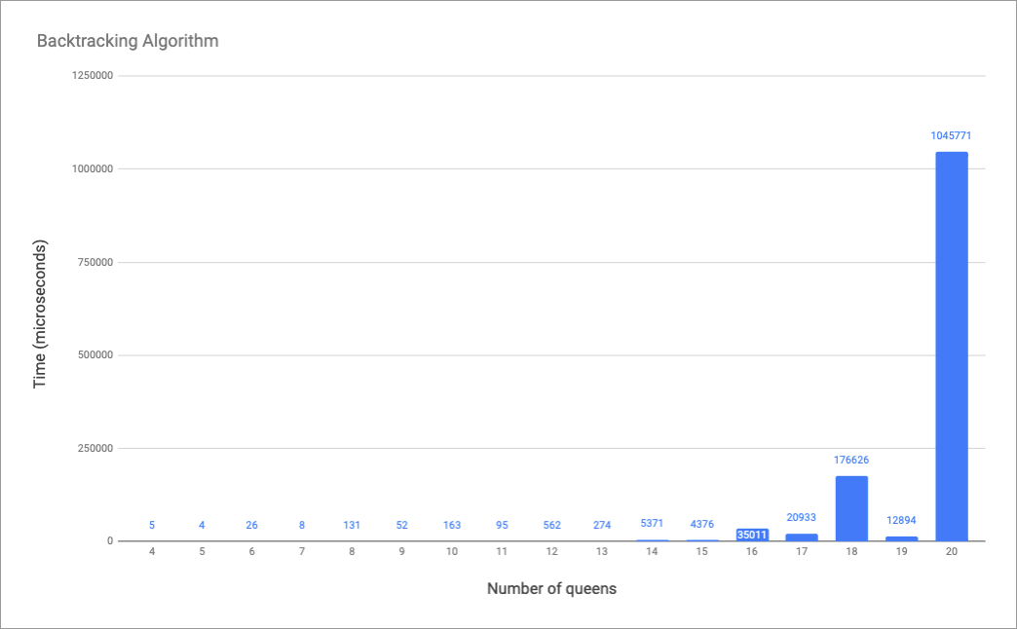
Test results: Backtracking

Slide 11
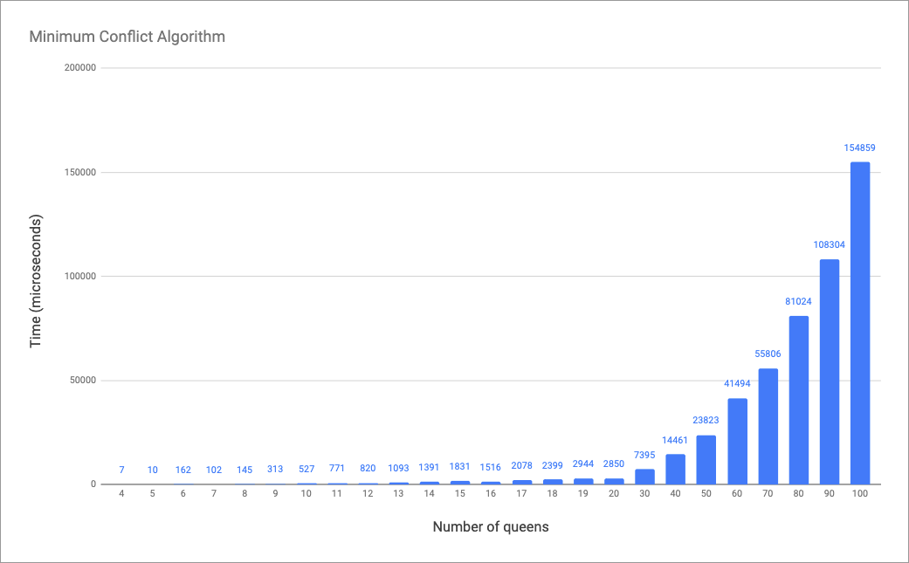
Test results: Minimum Conflicts with Backtracking

Slide 12
Discussion
From results, we can see that minimum conflicts with backtracking has significant improvement over backtracking alone
Can be attributed to the comparison between exponential (factorial) and linear time space complexities
Backtracking proven to be nearly useless when the input data becomes large enough

